Slide 1
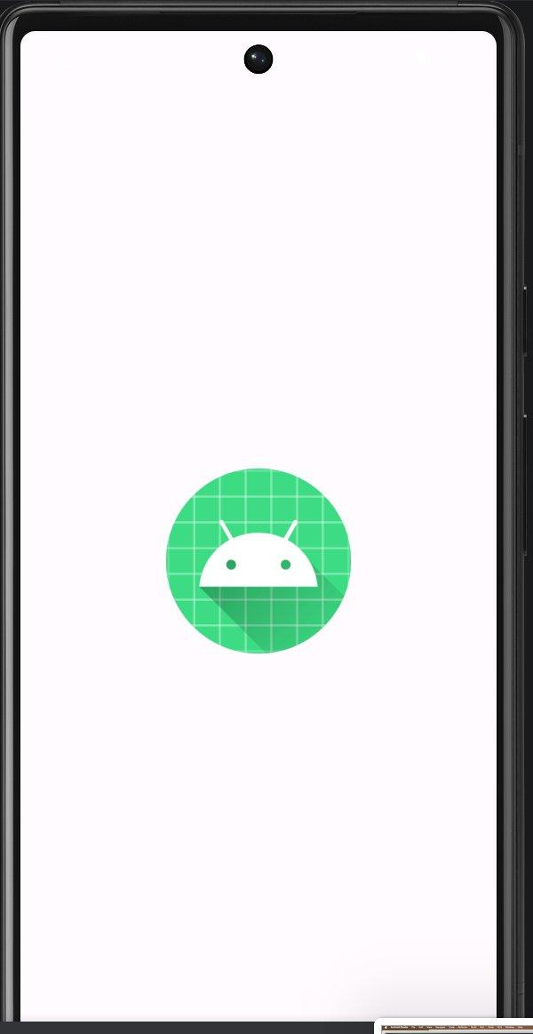
work_in_progress
Android Task Manager App
DePaul University | IS Senior Project | 2026
Presented by Team work_in_progress

Slide 2
Meet the Team
🛡️
Paul
⚙️
Ayaan
🔧
Voya
Scrum Master / QA
Backend Developer
Backend / QA
✍️
Farhan
🎨
Alexis
✨
Sahrish
Technical Writing
Frontend Developer
UI / UX Designer

Slide 3
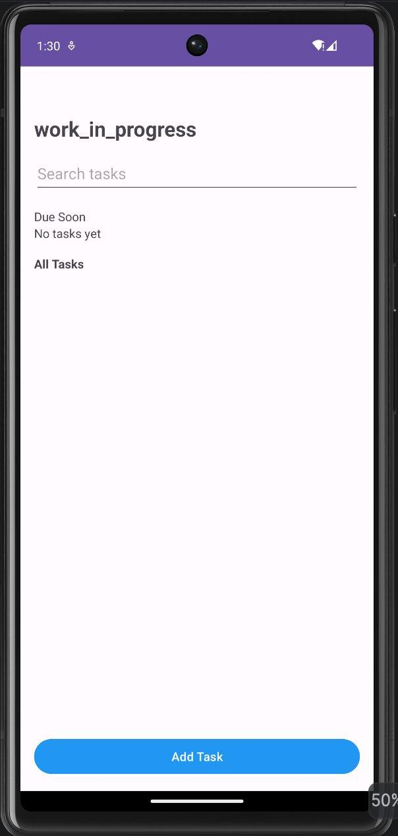
Project Overview
What is Work In Progress?
Work In Progress is a native Android task management app built with Kotlin and Android Studio. It helps users stay organized by creating, tracking, and managing their daily tasks — all in one clean, intuitive interface.
📱
Native Android (Kotlin)
🗄️
Room Database for local storage
🔔
Reminders & due-date alerts
🔍
Real-time task search

Slide 4
Key Features
✅
Task Management
🔍
Smart Search
⚡
Priority Levels
Create, edit, and delete tasks with title, notes, due date, and priority level
Filter tasks in real-time as you type in the search bar
Mark tasks as High, Medium, or Low priority for better focus
🔔
Reminders
📅
Due Dates
🗂️
Task Details
Toggle reminders so you never miss an important deadline
Assign due dates and see which tasks are coming up soon
Tap any task to view full details including notes and progress

Slide 5
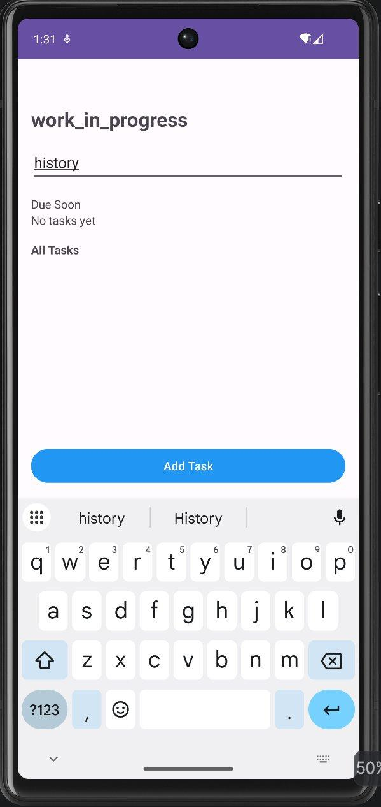
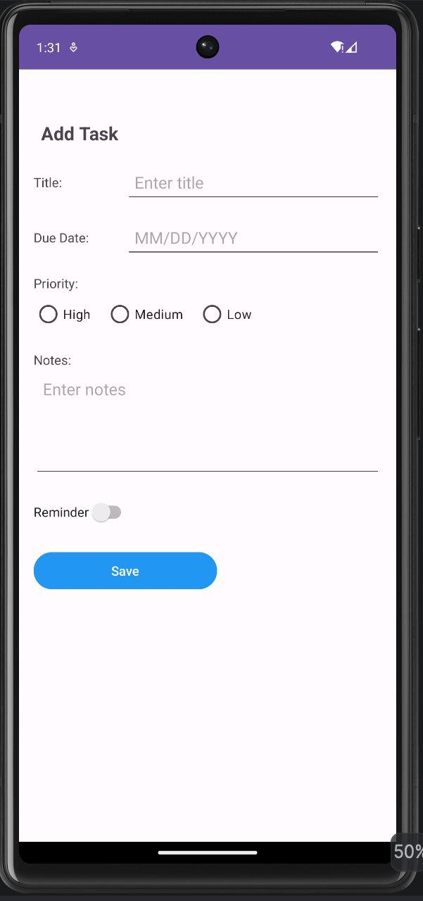
App Screens
Splash Screen
Home / Task List
Search in Action
Add Task Form
App launch with brand identity
All tasks, search & Add button
Live filtering as user types
Title, due date, priority & reminder

Slide 6
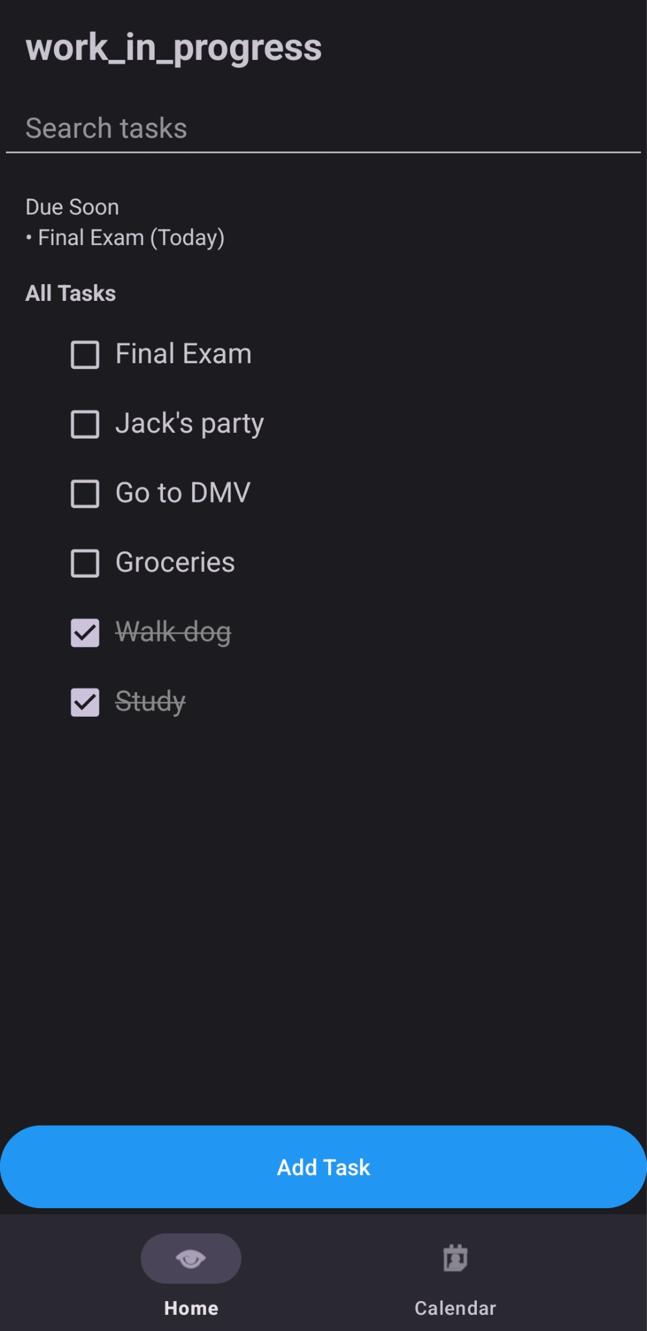
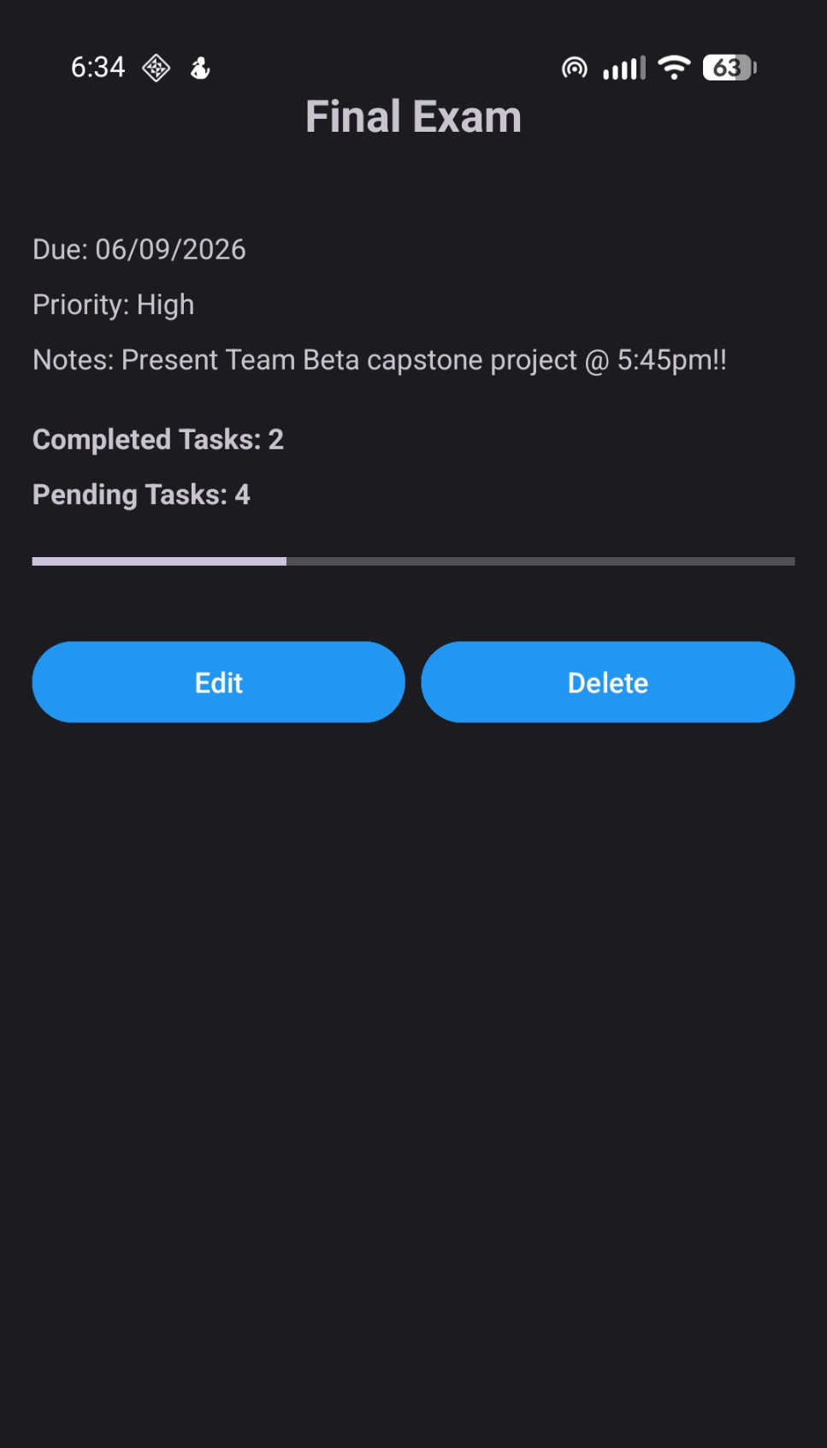
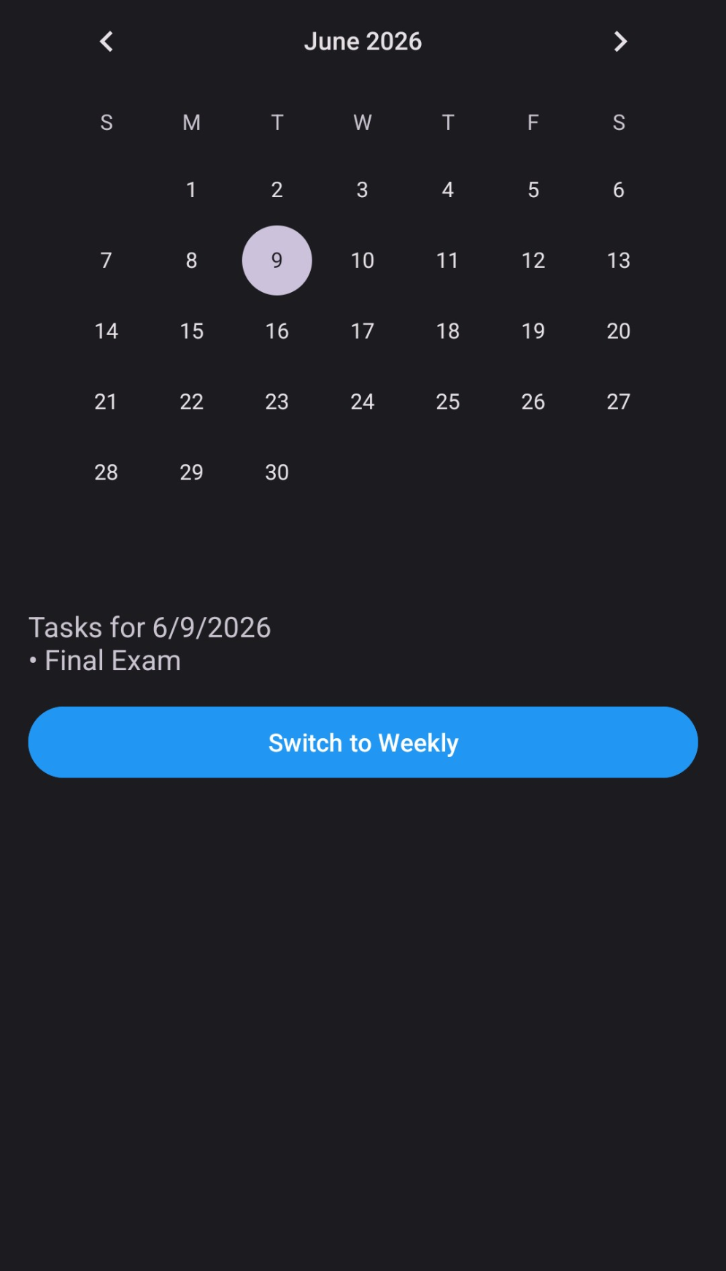
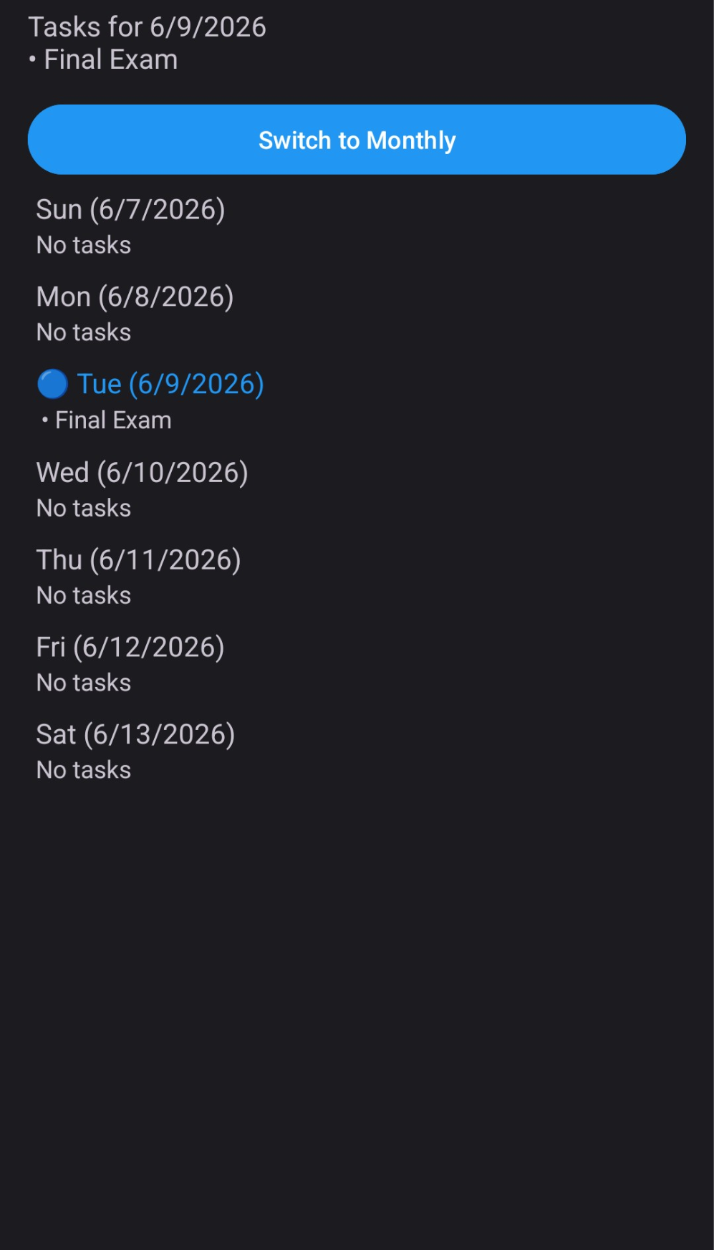
App Screens (cont.)
Task List (populated)
Task Details
Calendar View
Weekly View
All tasks, ordered by due date -> creation date -> completed
Displays task details, option to edit or delete, and total list completion
Displays scheduled tasks on selected date
Displays today’s scheduled tasks as well as upcoming ones this week

Slide 7
Technical Architecture
UI Layer
MainActivity · AddTask · EditTask · TaskDetail · CalendarActivity
▼
ViewModel Layer
TaskViewModel · ViewModelFactory — manages UI state & lifecycle
▼
Repository Layer
TaskRepository — single source of truth for data operations
▼
Database Layer
Room Database · TaskDao · Task Entity · TypeConverters

Slide 8
Testing & Quality Assurance
🧪 Unit Tests
🔗 Integration Tests
📱 E2E
✓ TaskViewModelTest
✓ AddTask_IntegrationTest
✓ TaskFlow_E2ETest
✓ TaskRepositoryTest
✓ EditTask_IntegrationTest
✓ TaskDaoInstrumentedTest
✓ TaskEdgeCasesTest
✓ TaskDetail_IntegrationTest
✓ MainActivity_SearchTest
✓ PriorityTest
✓ TaskViewModelIntegrationTest
✓ DataUtilInstrumentedTest
✓ DataUtilTest
✓ TaskRepositoryIntegrationTest
✓ TaskDaoTest
✓ TaskParamsTest

Slide 9
Challenges & Solutions
⚠️ ViewModel & Lifecycle
✅ Implemented ViewModelFactory to properly scope the ViewModel to the Activity lifecycle and avoid memory leaks
⚠️ Reminder Notifications
✅ Used AlarmManager with BroadcastReceiver (ReminderScheduler + ReminderReceiver) for reliable background notifications
⚠️ Search Filtering
✅ Added a TextWatcher on the search bar that filters the task list in real-time without additional database queries

Slide 10
Team Contributions
Paul — Scrum Master / QA
Ayaan — Backend Developer
🛡️
⚙️
Led sprints, managed Agile ceremonies, wrote and executed quality assurance test plans
Built Room database, TaskDao, Repository layer, and core data models
Voya — Backend / QA
Farhan — Technical Writing
🔧
✍️
Developed backend logic, contributed to integration and instrumented testing
Authored KDoc documentation, project README, and maintained code documentation standards
Alexis — Frontend Developer
Sahrish — UI / UX Designer
🎨
✨
Implemented Activity screens in Kotlin, connected UI to ViewModel, handled navigation
Designed the complete visual system — color palette, layouts, typography, and user experience flow across all screens

Slide 11
What We Learned
🏗️
MVVM Architecture
🤝
Agile Teamwork
🗄️
Room & SQLite
Learned how Model-View-ViewModel pattern creates maintainable, testable Android apps
Practiced real Scrum with sprints, standups, and iterative delivery as a 6-person team
Gained hands-on experience with local database persistence using Android Room ORM
🧪
Test-Driven Development
🎨
UX Design Process
📝
Documentation Matters
Wrote unit, integration, and E2E tests to ensure code reliability across layers
Translated user needs into clean, intuitive mobile UI with consistent visual design
Maintained KDoc and README documentation to keep the codebase understandable for all

Slide 12
Thank You!
work_in_progress — DePaul University | 2026
Paul · Ayaan · Voya · Farhan · Alexis · Sahrish
Questions?

